Slide 1
A MAJOR PROJECT
On
FACEMASK MONITORING SYSTEM
BACHELOR OF TECHNOLOGY
IN
COMPUTER SCIENCE AND ENGINEERING
BY
BIKKUMALLA RISHI PRANAY RAJ (17VE1A0512)
BHANDEKAR DINESH (17VE1A0511)
KAMAL PATEL (17VE1A0531)
THALLA ASHISH SAI (17UJ1A0522)
Under the Guidance of
Mrs. PULI . SRILATHA (ASSISTANT PROFESSOR)
ACADEMIC YEAR: 2017-2021

Slide 2

FACEMASK MONITORING SYSTEM
CONTENTS:
PROBLEM STATEMENT
SAMPLE CODE
TESTING
RESULTS
CONCLUSION
FUTURE SCOPE
REFERENCES

Slide 3
PROBLEM STATEMENT
To develop an API so that one can monitor humans whether they are wearing masks or not through CCTVs and take effective measures to control the spread COVID-19.

Slide 4
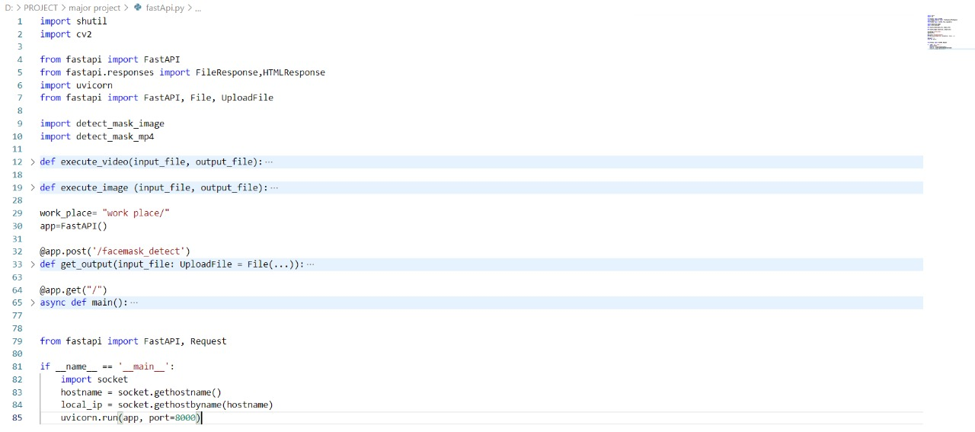
SAMPLE CODE

Slide 5
TESTING AND ANALYSIS
Software Testing is evaluation of the software against requirements gathered from users and system specifications. Testing is conducted at the phase level in software development life cycle or at module level in program code. Software testing comprises of Validation and Verification.
Unit Testing: We have performed testing while writing the code to get error free.
Integration Testing: We have integrated both the modules after completion of testing of individual modules.
Black box testing: After that we tested the behavior of the project entirely to see if the detection is working as expected or not.

Slide 6
Test Case and Expected Results(TCER)
Req_id | Tkt_id | Req_descrption | Expected Output | Actual Output | Req_tckt_status
1 | ID1 | Testing API | It should be diverted to the API. | It displayed the API. | Pass
2 | ID2 | Choose File | It should the select file. | It selected both images and videos. | Pass
3 | ID3 | Test Input Validation | API should accept valid input format (.png, .jpg, .jpeg,.mp4) if format is different send "bad request status 400 error". | It has allowed only the required input format. | Pass
4 | ID4 | Detecting Facemask | It should detect weather all human faces are wearing mask or not | It displayed green box if the person is wearing mask else displayed in red box | Pass
5 | ID5 | With mask | It should detect if mask is not wearing by individual humans in an image in different lighting conditions | It has some trouble while detecting masks in low light condition | Fail
6 | ID6 | Without mask | It should detect if mask is wearing by individual humans in an image in different lighting conditions | It detects no mask successfully even in low light. | Pass

Slide 7
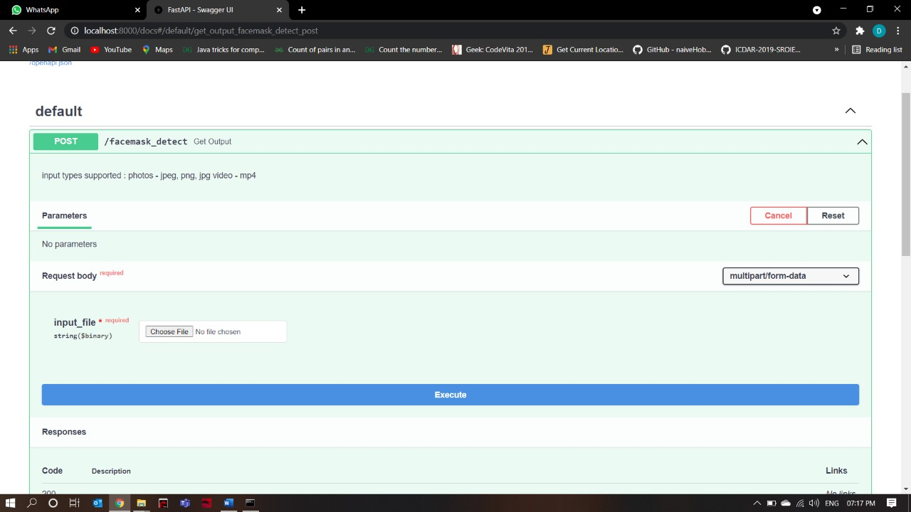

RESULTS

Slide 8
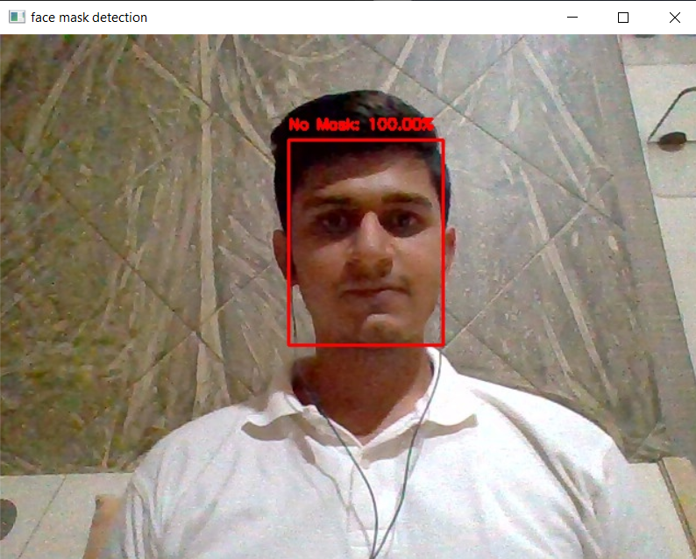
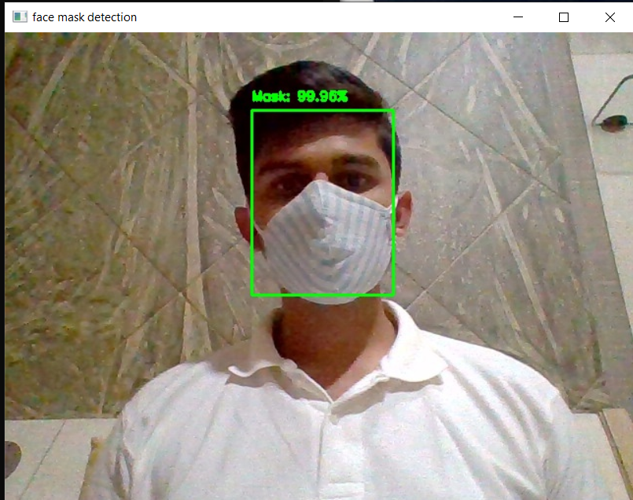
Case 1: IMAGE
Without mask
With mask

Slide 9
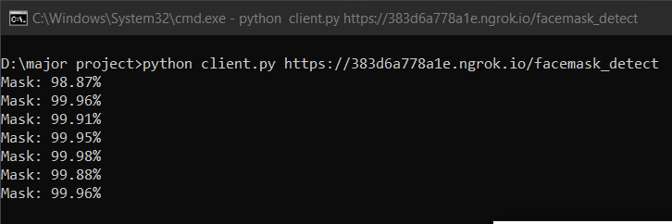
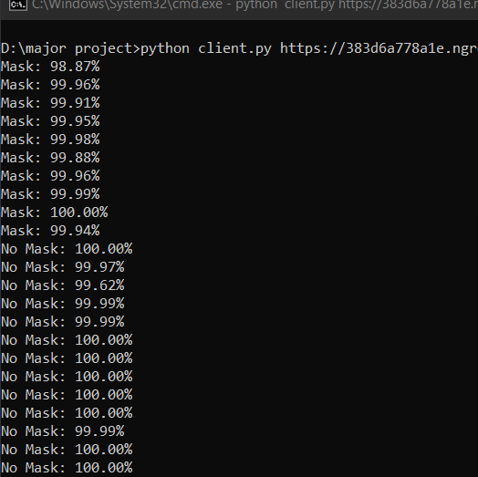


Case 2: VIDEO
With mask

Slide 10
CONCLUSION
By running this application, we can say that one can monitor facemasks through an API in large gatherings like shopping malls, theaters, events etc. It also tells whether a person is wearing mask or not. Task of the human are reduced because of automation since there is no need of monitoring the persons.

Slide 11
FUTURE SCOPE
If this application is integrated with the employees database in organizations if the employees aren't wearing masks properly then we can be able to send the warning message to that employee using his/her id .We can also implement the concept of social distancing that would make it a complete system which can bring a dramatic impact on the spread of virus.

Slide 12
REFERENCES
https://www.starlette.io/
https://towardsdatascience.com/
https://github.com/tensorflow/tensorflow
https://www.pyimagesearch.com/2018/02/26/face-detection-with-opencv-and-deep-learning/
https://paperswithcode.com/method/mobilenetv2
https://swagger.io/tools/swagger-ui/#
https://fastapi.tiangolo.com/
https://arxiv.org/abs/1801.04381

Slide 13
THANK YOU

